Slide 1
Notes:
Introduction

Slide 2
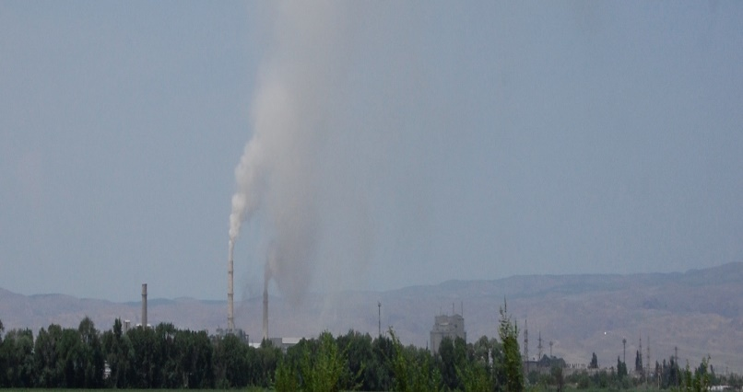
Air Pollution
Air pollution is the mix of hazardous substances from both human-made and natural sources.
Six common air pollutants:
Ground-level ozone
Particulate matter
Carbon monoxide
Lead
Nitrogen oxides
Sulfur oxides
Notes:
The primary sources of air pollution are vehicle emissions, coal-fueled power plants, fuels and natural gas used to heat homes, manufacturing and power generation, and fumes from chemical production.
The EPA has set a National Ambient Air Quality Standard for each criteria air pollutant. Ground-level ozone is the primary concern in North Texas

Slide 3
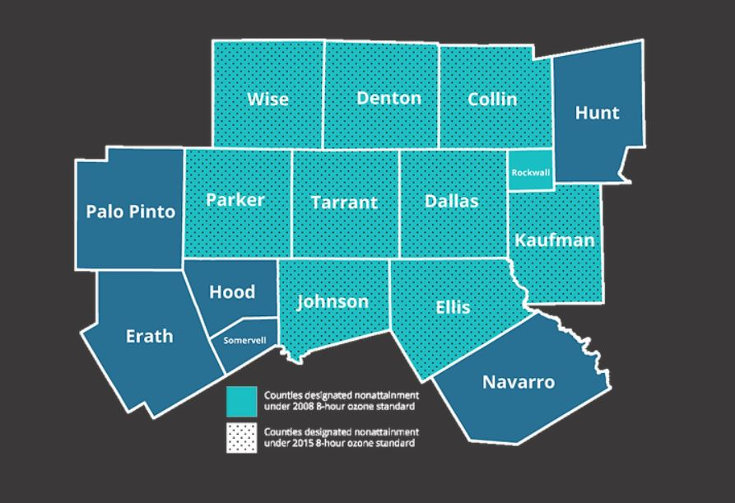
Our Air Quality Problem
Notes:
10 counties in North Texas are designated nonattainment under the 2015 8-hour ozone standard.
A nonattainment area is an area considered to have air quality worse than the National Ambient Air Quality Standards as defined by the Clean Air Act.
The 2015 standard is 70 ppb or less while the 2008 standard is 75 ppb

Slide 4
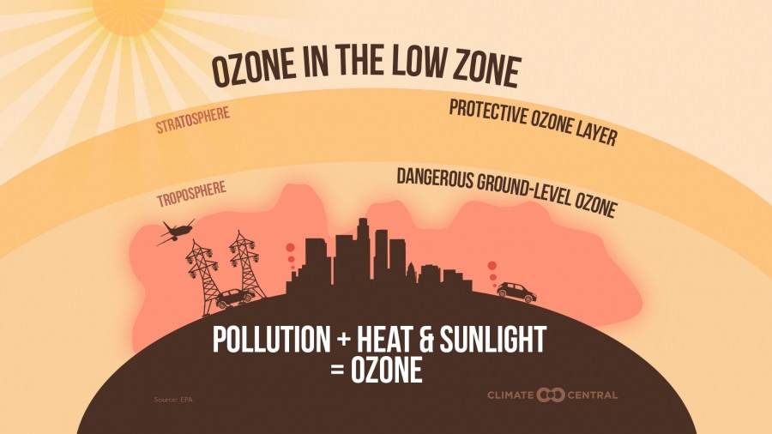
Ozone: Good versus Bad
“Good Ozone” exists naturally high in the atmosphere
“Bad Ozone” forms when emissions combine with sunlight and intense heat.
Notes:
Good Ozone: Sunscreen, Protects from UV radiation, between 30,000-50,000 feet, stratosphere
large quantities of man-made organohalogen compounds, especially chlorofluorocarbons (CFCs)
Bad Ozone: VOC formations from cars, power plants, industrial boilers, refineries, and other sources during heat of summer. Ozone season in North Texas is March-November.
Ground level or "bad" ozone is not emitted directly into the air but is created by chemical reactions between oxides of nitrogen (NOx) and volatile organic compounds (VOC) in the presence of sunlight.

Slide 5
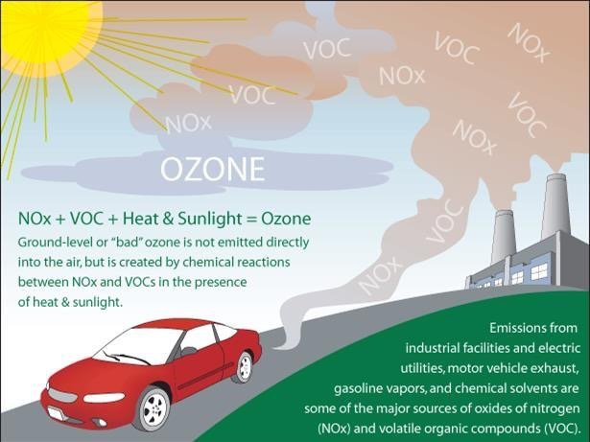
Causes of High Ozone
Lawn equipment, air-craft, trains, etc.
Power plants, bakeries & Laundry mats
Burning vegetation
Half of North Texas’s Bad ozone comes from vehicles

Slide 6
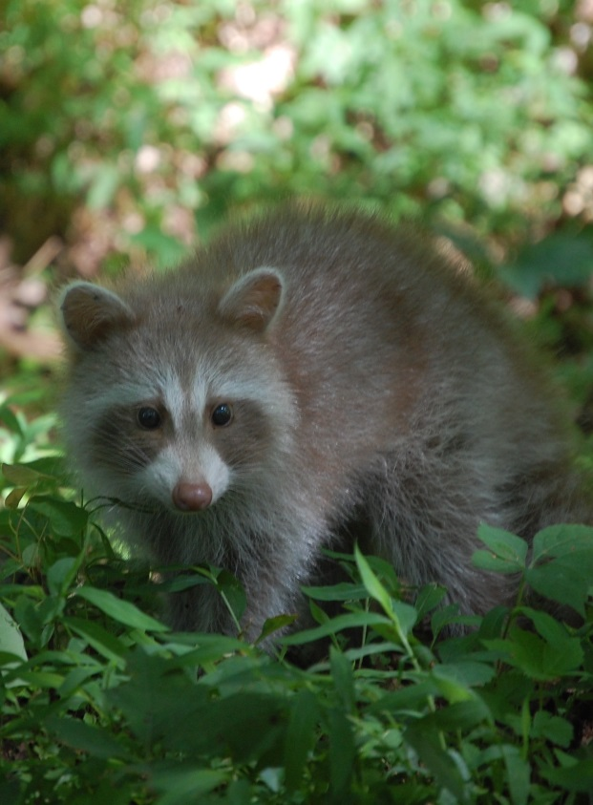
What this means for North Texas
Public Health and Quality of Life
Environmental Health
Economic
Development
Notes:
Public Health: Inhaling ground-level ozone is dangerous for young children, who may also be at risk for developmental problems.
Also, it’s dangerous for people with asthma or respiratory problems.
Ozone Causes Coughing, Throat irritation, Pain, burning or discomfort when taking a deep breath, Chest tightening and Shortness of breath
Environmental: Ground ozone harms sensitive vegetation during the growing season.
Bad for Business: Not meeting standards means… Air permits required & Restrictions on operations
-Billions lost in economic output
-Businesses are less likely to invest

Slide 7
Health Effects
Coughing
Throat irritation
Chest tightening
Burning or discomfort when taking a deep breath
Shortness of breath
Notes:
Ozone forms when emissions combine with sunlight and intense heat. High ozone can cause health problems:
Inhaling ground-level ozone is especially dangerous for people with asthma or respiratory problems. Since children’s lungs are still developing, they are at greatest risk from exposure.
On high ozone days, reduce time spent outdoors.

Slide 8
Environmental Effects
Reduction in photosynthesis
Slows plant growth
Increase risk of disease
Changes in habitat quality
Changes to water and nutrient cycles
Notes:
Ozone affects vegetation and ecosystems such as forests, parks, wildlife refuges, and wilderness areas are affected by ozone.
Sensitive vegetation is especially at risk during growing season.
Increase risk of harm from severe weather and damage from insects.

Slide 9
Economic Impacts
Air permits required & Restrictions on operations
Billions lost in economic output
Businesses are less likely to invest
Notes:
Economic development is directly impacted. Businesses are less likely to invest in nonattainment designated areas.
Industrial facilities are be required to install pollution control equipment, take limits on their production, or find reductions in emissions.

Slide 10
What You Can Do!
Carpool, combine errands, don’t idle!
Bring your lunch to work
Ensure car tires are properly inflated
Ride a bike or walk
Fill up on gas in the morning or at night
Sign up for Air Quality Alerts

Slide 11
Air Quality Index (AQI)
Check daily at www.airnorthtexas.org
Notes:
Great website, sign up for ozone alerts.
On high ozone days, try to do actions that limit air pollution and refrain from spending too much time outdoors.
Other action ideas include:
Telecommunicating
Obeying the speed limit
Avoid idling
Maintaining vehicle
Keeping tires properly inflated
Changing filters regularly
Post poster/fliers around the office
Create a display about clean air awareness
GET CREATIVE!

Slide 12
The Challenge
Education, like this presentation, is part of it!
More Challenge info and ideas: www.gptx.org/CleanAir
Take the Pledge: At the booth, or for those not here…
www.airnorthtexas.org/cleanairactionday
Make sure you submit the application and supporting documents by Friday, 6/7/24
Notes:
get good pledge % totals will help
Continue ideas throughout the year

Slide 13
What are some forms of air pollution?
Smoke
Haze/smog
CO2
All of the above
Notes:
D. Most of these pollutants typically result from the burning of fossil fuels like coal and gasoline.

Slide 14
What type of pollution is not pumped out directly from cars and trucks?
Volatile organic compounds
Carbon monoxide
Ground-level ozone
Nitrogen dioxide
Notes:
C. Ground-level ozone is formed when pollution from vehicles, factories, and other sources reacts in sunlight.

Slide 15
Is ozone good or bad for humans?
Good
Bad
Both
Neither
Notes:
C. Ozone can be found in Earth’s upper atmosphere and at ground level. Ozone is good for us when it is above the stratosphere where it protects us from harmful UV rays. At ground-level, ozone acts as a pollutant because it is formed when pollution reacts with sunlight. Smog is a result of high ground-level ozone and can be harmful to our health.

Slide 16
Which of the following is one of the six common air pollutants?
Ground-level ozone
Nitrogen dioxide
Particulate matter
All of the above
Notes:
D. The six common air pollutants, also known as “criteria air pollutants”, are ground-level ozone, particulate matter, carbon monoxide, lead, sulfur dioxide, and nitrogen dioxide.

Slide 17
When is ozone season in North Texas?
Notes:
March-November

Slide 18
The Earth’s ozone layer protects living things from too much .
Notes:
UV Radiation

Slide 19
What year was the Clean Air Act first passed?
Notes:
1970

Slide 20
When is Clean Air Action Day?
Notes:
June 2, 2023

Slide 21
Clean Air Action Day
Notes:
Get them to think about what they can do on CAAD
What is your One Thing?
And what habits they can repeat to help our air quality problem and what simple solutions they can educate other on!

Slide 22
Questions?
Kylie Wieden
Environmental Outreach Coordinator
(972) 237-8229
kcwieden@gptx.org

